Slide 1


Slide 2



Slide 3
Why is a data governance solution needed?
Hybrid Workplace
No traditional perimeter security
Dark Data
Distributed data estate
Unified view for Risk and Compliance
Data sharing

Slide 4
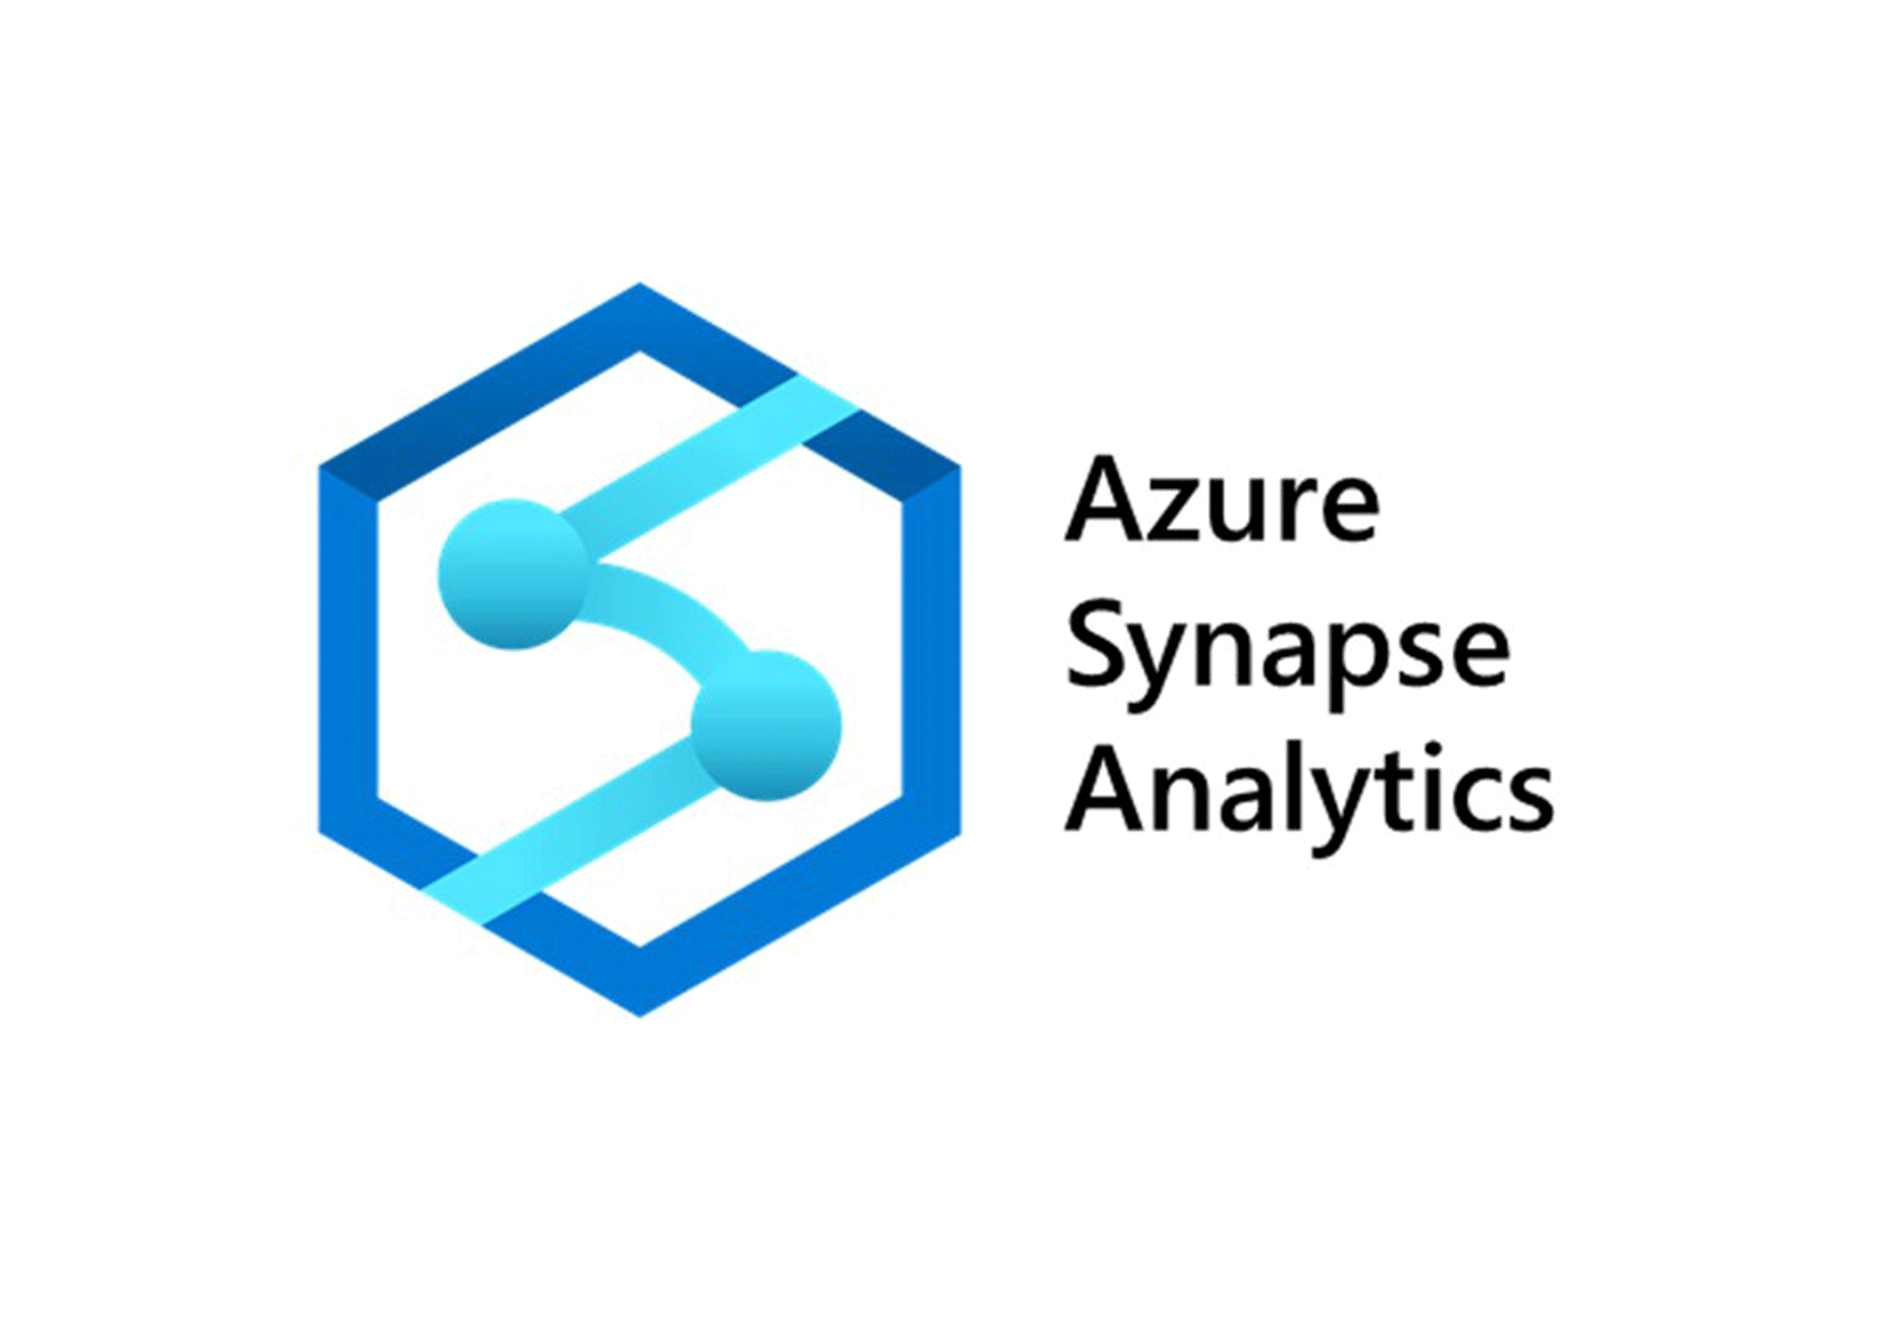










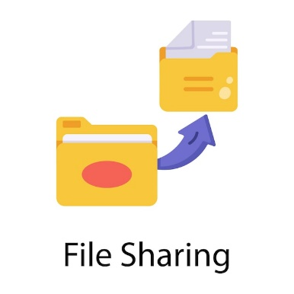


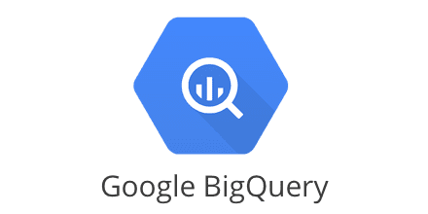






The rabbit hole goes deep…
Is this data sensitive?
What data is this?
Whose data or share is this?
Does this data have personal identification information?
Is this the current data?
Why do they have access?
Who has access to this data?

Slide 5
Information protection and data lifecycle management
Know your data
Protect your data
Prevent data loss
Govern your data
Understand your data landscape and identify important data across your hybrid environment.
Apply flexible protection action including encryptions, access restrictions and visual markings.
Detect risky behavior and prevent accidental oversharing of Sensitive information.
Automatically retain delete and store data and records in a compliant manner.

Slide 6
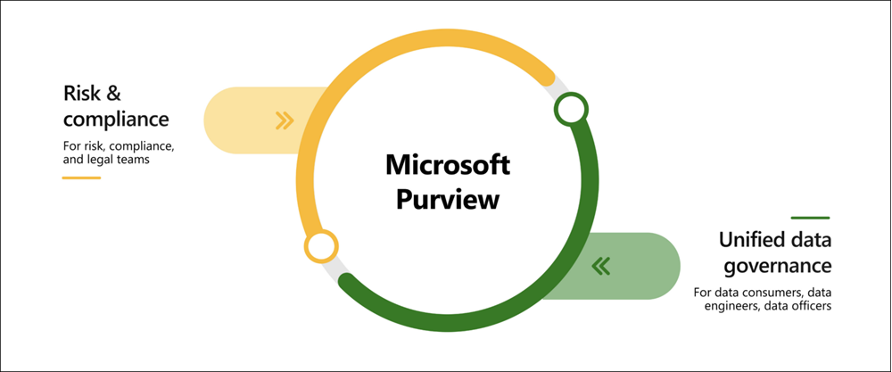

What is Microsoft Purview?
“Microsoft Purview is a family of data governance, risk, and compliance solutions that can help your organization govern, protect, and manage your entire data estate.” - Microsoft Docs
We discuss this

Slide 7
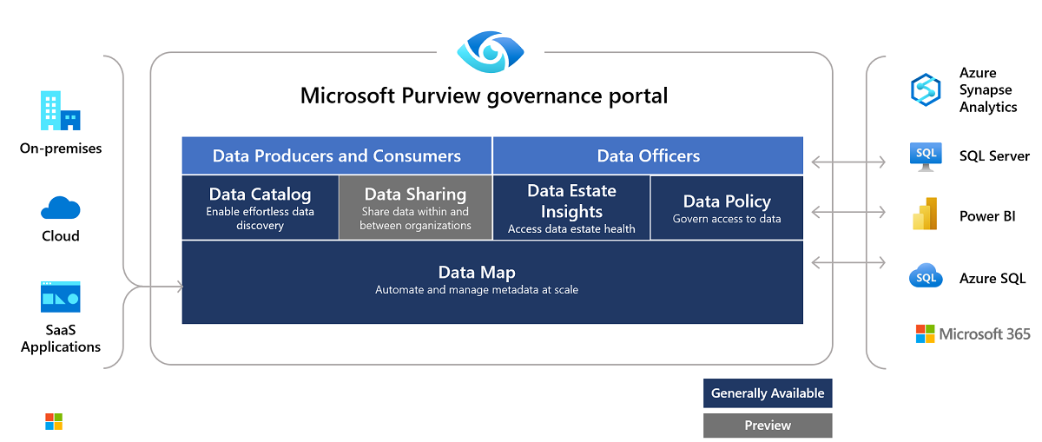
Data governance with Microsoft Purview

Slide 8
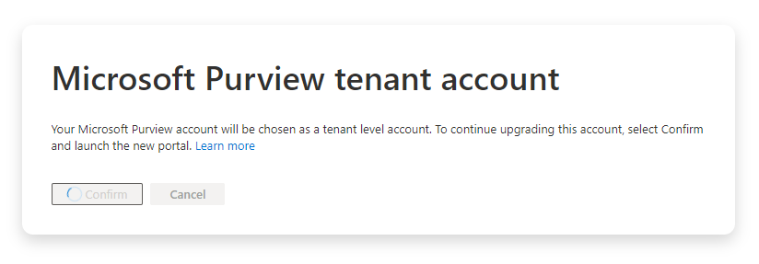

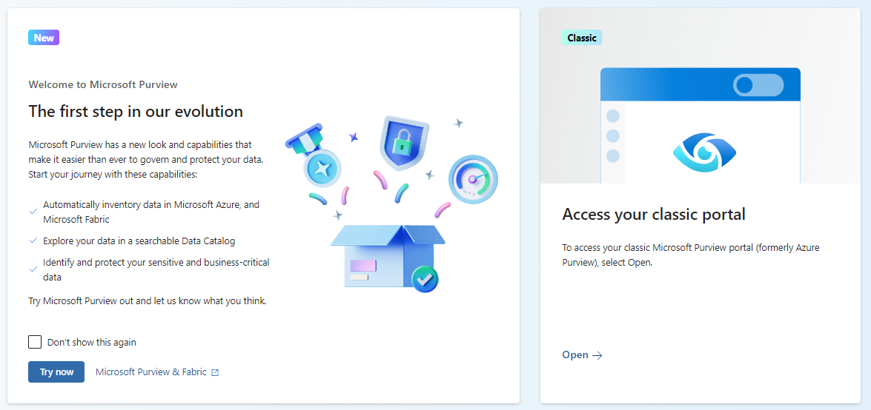

Migrate to the new portal

Slide 9
Data enrichment
Business Glossary Terms
Define the business vocabulary for an organization
bridge the gap between technical data and its everyday context
Classification
Assigned descriptors to an assets to tell what kind of data it is
Example: Passport number, Credit card number
Sensitivity labels
used to identify the categories of classification types
Managed attributes
Example: Financial report for Company X
group security policies that you want to apply to each category
Example: Sensitive, Confidential
a set of user-defined attributes that provide more description or context for assets
Usually has a name and a value
Example: Department- Finance

Slide 10
Permissions
Collection Admin
Define, configure collection
Data source admin
Identify and prepare data source
Register sources
Data curator (Data owner)
Review collection assets
Define classification rules
Data curator (Data Steward)
Data reader
Assign roles to collection
Ingest sources via scan or api
Assign assets managers
Move assets
Review request for asset deletion
Review or update meta data
Review or update glossary terms
Request asset movement to new collection
Review asset access
Request asset metadata deletion
Search data/glossary and classification
Access sensitivity, classification, ownership information
Review asset access
Request asset metadata deletion

Slide 11
Wrap up
Use easy language
Devil may not be details
Balance security and convenience
Educate and train
Involve stakeholders and leadership
It takes time
Moving target

Slide 12
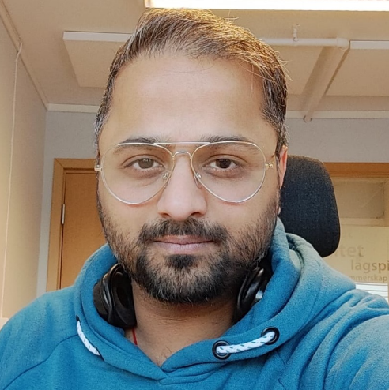


Mohit Sharma
Chief Consultant, Atea
https://www.linkedin.com/in/mohitsharma13/

